Slide 1
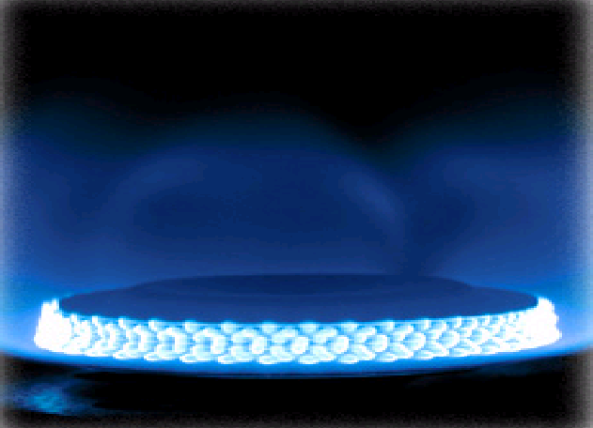
Strategic Analysis of Technology Selection and Capacity Choices in the LNG Industry
Erkut Sönmez
Boston College
Carroll School of Management
Joint work with Sunder Kekre, Alan Scheller-Wolf, Nicola Secomandi
Carnegie Mellon University
Tepper School of Business
Informs - Austin
2010

Slide 2
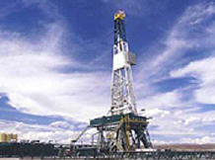
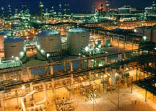
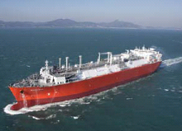
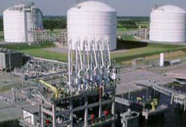
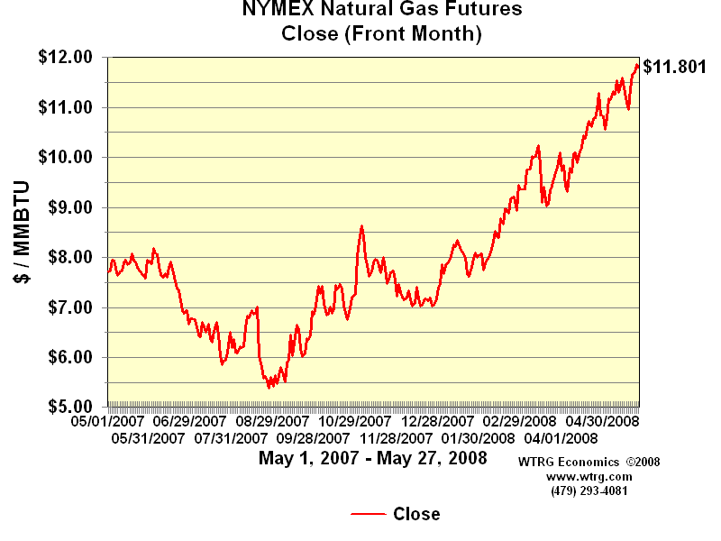
Liquefied Natural Gas (LNG) Supply Chain
Natural Gas Production
Liquefaction Plant
LNG Shipping
Regasification Terminal
Market

Slide 3
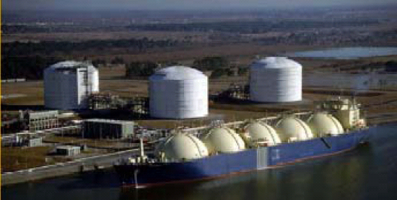
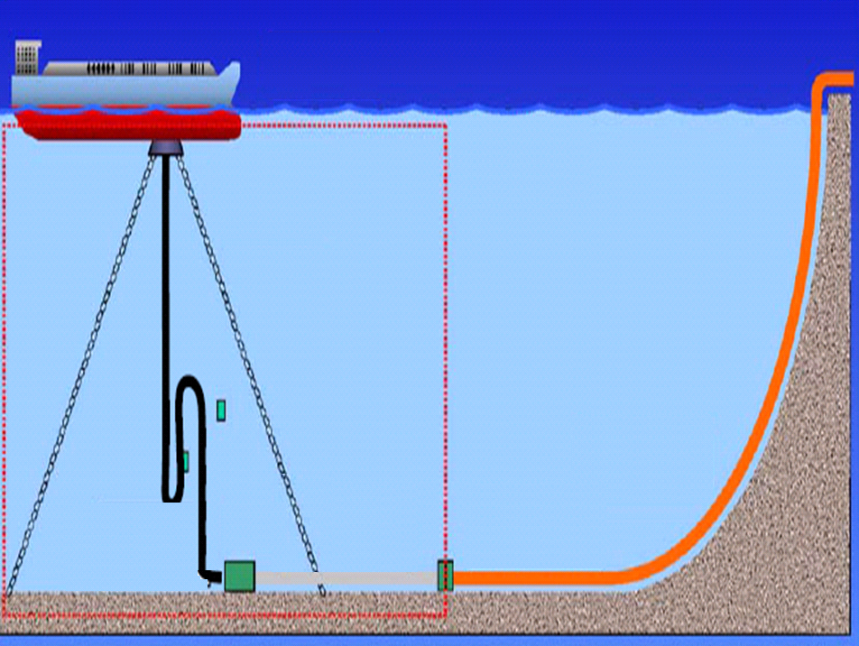
Regasification Technologies
Two Types
Incumbent
Onshore-Terminal Regasification
Emerging
Onboard Regasification
LNGRV
Deep-Water Port
LNGC

Slide 4
Tradeoff
Fast
Long time to build
Onboard
Slow
Short time to build
Cheap
Onshore
Expensive
QUESTION 1: Under what conditions should each regasification technology be adopted?

Slide 5

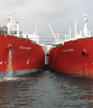


LNG Transshipment with Onboard Technology
LNGC
LNGRV
Ship to Ship LNG Transfer
Liquefaction
Plant
Unloading: Offshore Deepwater Port
LNGRV
LNGC
QUESTION 2: If onboard technology is adopted, what is the potential benefit of LNG transshipment?
PRACTICE: Open Question (CEO of Excelerate Energy)

Slide 6
Model
N: Resource levels – number of LNGRVs, LNGCs and buoys
X^{T} : Target LNG throughput requirement
Stochastic
(CQN, Simulation)
Deterministic
QUESTION 3: What is the impact of modeling approach on strategic technology and capacity choices?

Slide 7
Field Study
Parameters
Loading port service time (mean): 1 day
Unloading port service time (mean):
Onshore: 1 day
Onboard: 7 days
15 days
Louisiana
USA
Regasification
Terminal
EGYPT
Liquefaction
Plant
Ship Cargo Capacity: 3bcf
LNGRV: $275M
LNGC: $250M
Onshore terminal: $1.5B
Deep-water port (1 buoy): $70M
15 days

Slide 8
NYMEX Natural Gas Futures Prices
Forward Curve as of 8/8/2008
$\MMBTU
Project life time: 25 years

Slide 9
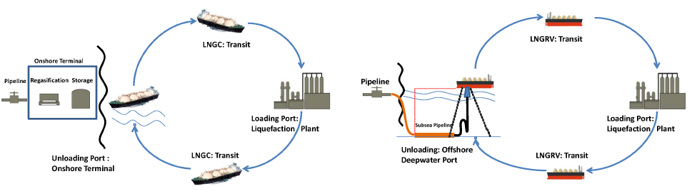
Technology Comparison: Onboard vs Onshore
Incumbent onshore terminal based regasification
Emerging onboard regasification without transshipment

Slide 10
Technology Adoption Choice
4
3
Onboard
No-Dominance
Lead time difference - LTD -(years)
2
1
Onshore
0
0.5
1
1.5
2
Throughput (bcf/d)

Slide 11
Technology Adoption Choice: Deterministic Analysis
4
3
OB
No-Dominance
2
LTD (years)
1
OS
0
0.5
1
1.5
2
Throughput (bcf/d)
Deterministic models are adequate to support technology selection choices in extreme cases (high, low LTD), but unlikely to be so otherwise

Slide 12
Benefit of LNG Transshipment
No-Transshipment minus Transshipment
NPV Difference ($B)
LNG Throughput (bcf/d)
LNG supply chains with OB technology should be developed only using dedicated LNGRVs rather than a mixture of these and conventional LNGCs

Slide 13
Benefit of LNG Transshipment: Deterministic Analysis
No-Transshipment minus Transshipment
NPV Difference ($B)
LNG Throughput (bcf/d)
Deterministic models are adequate to compare systems with and without transshipment

Slide 14
Impact of Modeling Uncertainty
CV of actual processing times can be in the range of 0.15 - 0.25 (Koenigsberg and Lam)
 |  | CV = 0.15 |  | CV =0.25
 |  | Throughput Loss | NPV Loss | Throughput Loss | NPV Loss
Onboard | Exponential Model | 0% | $0.275B (0.9 %) | 0% | $0.275B (0.9 %)
 | Deterministic Model | 6.31% | $4.95B (5.3%) | 8.90% | $6.47B (6.96%)
Onshore | Exponential Model | 0% | $0.25B (0.65%) | 0% | $0.25B (0.65 %)
 | Deterministic Model | 3.89% | $3.62B (3.44%) | 4.47% | $4.25B (4.1%)
Errors due to ignoring variability (deterministic) is much significant than amplifying (exponential) it.

Slide 15
Conclusions
We study LNG regasification technology selection and capacity choices motivated by the recent developments in this industry
We identify the conditions under which a specific regasification technology and its configuration is appropriate for adoption.
Some of our insights attribute a different role to the emerging technology than currently envisioned; others offer new perspectives on pressing issues encountered by LNG companies
We also analyzed the impact of modeling approach on strategic technology selection and capacity choice decisions.
Our models can be adapted to study a broader class of technology choice and configuration problems (e.g., Floating LNG liquefaction)

Slide 16
THANKS
QUESTIONS & COMMENTS
ERKUT SONMEZ
Boston College
Carroll School of Management
sonmeze@bc.edu

